Slide 2
OT Threats More Frequent & Sophisticated
2021 TO 2023
2015 TO 2020
2009 TO 2014
THREAT LANDSCAPE SHIFTS
21 Unique Threat Groups
ICS Malware: INDUSTROYER2, PIPEDREAM
Ukraine: electric substation attacks (2021/2022)
Oldsmar, FL: Water Treatment attack
Hacktivist Attacks: disruption of water utilities in U.S., Europe (2023)
Ransomware attacks: Colonial Pipeline, JBS Foods, Norsk Hydro, Kojima, Foxconn, Dole, Yanfeng Automotive, Boeing
1998 TO 2008
ADVERSARIES DISRUPT ICS
ICS Malware: BlackEnergy2, CRASHOVERRIDE, TRISIS
Campaigns: Dragonfly 2.0
Ukraine: disruption of electric power operations (2015), major electric grid disruption (2016)
Saudi Arabia: first attack targeting human life (2017)
CAMPAIGNS TARGET ICS
ICS Malware: Stuxnet, Havex
Campaigns: Sandworm, Dragonfly
Ukraine: Germany: 1st attack cause physical destruction on civilian infrastructure (steel)
LACK OF COLLECTION
Campaigns: APT1
ICS Malware: None

Slide 3
Ransomware Attacks Increased by 50%
2023 Had 905 Ransomware Attacks Against Industrial Organizations
RANSOMWARE BY ICS SECTOR
Equipment
93
638 Manufacturing
13 Mining
Food & Beverage
73
Consumer
64
115 Industrial Control Systems
10 Water
Construction
54
638
Electronics
53
10 Renewables
49
65 Transportation
Metals
2 Government
Automotive
48
30 Oil & Gas
Chemical
40
2 Defense
Pharmaceuticals
37
20 Electric
Packaging
23
Healthcare
21
Plastics
20
RANSOMWARE SPREADS IN FLAT NETWORKS
28% of customer engagements had findings of segmentation issues or improperly configured firewalls
Aerospace
19
Glass, Paper *
4
14
Agriculture, Defense *
3
Textile
1
Recycling, Stone *
* each
Maritime
6
Semiconductor
5
Notes:
And we see the growth in these kind of attacks year over year, driven by money and malice. There were 905 ransomware attacks in 2023, that’s an increase of 50% over 2022.

Slide 4
SEC Cybersecurity Risk Management Rules
Requires public companies to disclose cybersecurity incidents withing 4 days
Board and leadership oversight is required to assess materiality of an incident

Slide 5
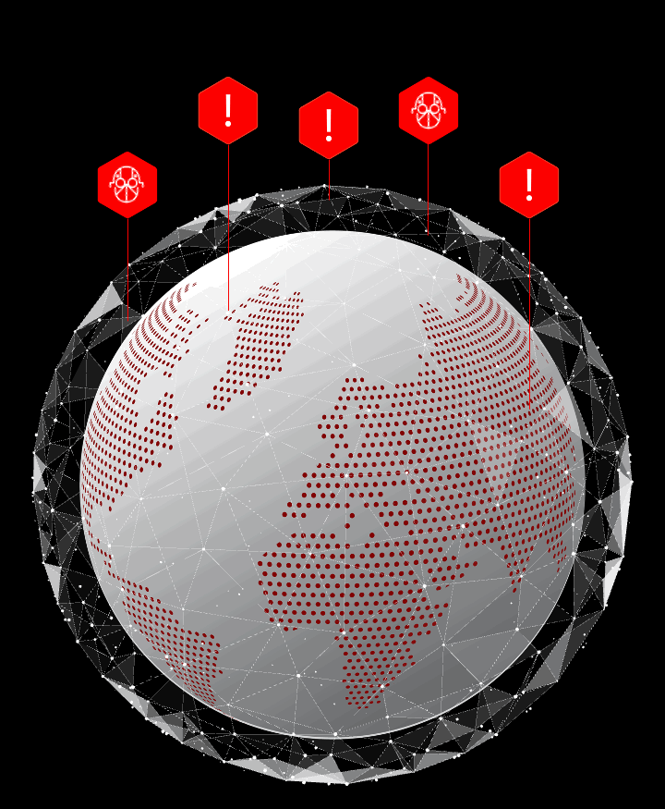
Unifying IT & OT
A New Era In Cyber Defense
Today’s Reality
Increase in OT and IT networks being interconnected
Networks must work in harmony to keep operations running
Increase in interconnection opens up opportunity for advanced threats
The Risks
Lack of unity creates blinds spots for adversaries to exploit
Operational shutdowns = catastrophic financial losses
Failure to unify risks the consequences of noncompliance in regulatory requirements
Looking to the Future
Endless scalability is matched with seamless increase in security, no matter how fast networks grow
Notes:
And we see the growth in these kind of attacks year over year, driven by money and malice. There were 905 ransomware attacks in 2023, that’s an increase of 50% over 2022.

Slide 6
ICS/OT Cyber Security Journey
3-12 Months
12-24 Months (+ongoing)
1-3 Months
BASELINE ASSESS, PLAN, & ORGANIZE
OPERATIONALIZE DRAGOS PLATFORM OT RISK CONTROLS
OPTIMIZE MATURE OT RISK REDUCTION PROGRAM
Establish Baseline (leverage Dragos Platform)
Conduct Architecture Assessment
Create an Incident Response Plan
Organize your assets inventory & collection management framework
Operate Dragos Platform
Monitor OT assets & network traffic in Crown Jewel sites
Identify & manage key OT vulnerabilities
Detect & respond to OT incidents
Expand & Mature
Expand deployment to medium & low impact OT sites
Integrate OT incidents & intelligence with IT SOC
Validate defensive controls
ICS Incident Response Plan
Defensible Architecture
ICS Network Visibility & Monitoring
Secure Remote Access
Risk-Based Vulnerability Management
1
2
3
4
5

Slide 7
IT/OT Unified SOC
Cyber Threat Intelligence
Endpoint Protection
ICS-aware asset and threat context
XIoT-Specific Threat Detection
ICS Vendor Testing & Validation
XIoT Detections Across 1st & 3rd-Party Domains
Asset Relationship & Risk Prioritization
Detect Changes Made to XIoT Apps & Project Files
Prioritized Threat &
Vuln Notifications
CrowdStrike
Falcon® Next-Gen SIEM
Incident workflow
and orchestration
Dragos Worldview OT Cyber Threat Intelligence
Cyber Threat Intelligence
Pivot & Drill Down
Enable a coordinated response
OT Watch Proactive Threat Hunting
Contextualized IOCs for OT
Lab-Tested Vulns
OT Adversaries, TTPs, Threat Scenarios
Threat Detection
Incident Response
Proactive Defense
Unified Security Across IT, XIoT & OT
CrowdStrike Falcon®
Insight for IoT
Active Threat Detection
DRAGOS OT MONITORING PLATFORM
OT, IOT, IIOT Asset ID, Profile, & Inventory
Real-Time Threat Intel
Intelligence-Driven Threat Detection
Rapid Threat Response
ICS Network
Visibility and
Security Monitoring
Risk-based Vulnerability Management
AI-Powered Detection
Endpoint security
Response Playbooks
Notes:
Cyber Threat Intelligence
Anticipate & prioritize OT threats
Contextualize security alerts
Enhance incident response
Dragos WorldView
Contextualized IOCs for OT
Vulnerability mitigations
Sector OT threat landscape
OT adversary TTPs, threat scenarios

Slide 8
Q
&
A
CrowdStrike + Dragos Resources
Comprehensive Cybersecurity for IT and OT Networks
https://www.dragos.com/partner/crowdstrike/
CrowdStrike Marketplace
Dragos Endpoint Asset Enrichment for Operational Technology (OT)
https://marketplace.crowdstrike.com/partners/dragos
5 Critical Controls
Benchmarking Guide: Secure Your Industrial Operations with the SANS ICS 5 Critical Controls
https://hub.dragos.com/guide/secure-industrial-operations-sans-five-critical-controls
QUESTIONS AND ANSWERS

